Slide 1
Normalization in DBMS

Slide 2
Normalization
Normalization in DBMS is a technique using which you can organize the data in the database tables so that:
There is less repetition of data,
A large set of data is structured into a bunch of smaller tables,
and the tables have a proper relationship between them.
DBMS Normalization is a systematic approach to decompose (break down) tables to eliminate data redundancy(repetition) and undesirable characteristics like Insertion anomaly in DBMS, Update anomaly in DBMS, and Delete anomaly in DBMS.
It is a multi-step process that puts data into tabular form, removes duplicate data, and set up the relationship between tables.

Slide 3
Why we need Normalization in DBMS?
Eliminating redundant(useless) data, therefore handling data integrity, because if data is repeated it increases the chances of inconsistent data.
Normalization helps in keeping data consistent by storing the data in one table and referencing it everywhere else.
Storage optimization although that is not an issue these days because Database storage is cheap.
Breaking down large tables into smaller tables with relationships, so it makes the database structure more scalable and adaptable.
Ensuring data dependencies make sense i.e. data is logically stored.

Slide 4
Types of DBMS Normal forms
Normalization rules are divided into the following normal forms:
First Normal Form
Second Normal Form
Third Normal Form
BCNF
Fourth Normal Form
Fifth Normal Form

Slide 5
First Normal Form (1NF)
It should only have single(atomic) valued attributes/columns.
Values stored in a column should be of the same domain.
All the columns in a table should have unique names.
And the order in which data is stored should not matter.

Slide 6
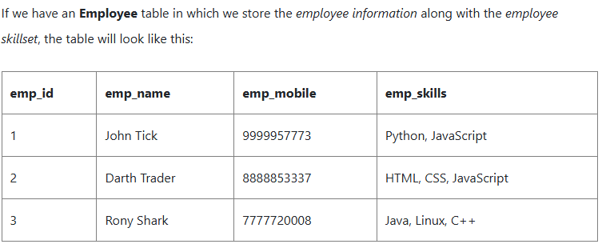
First Normal Form (1NF)

Slide 7
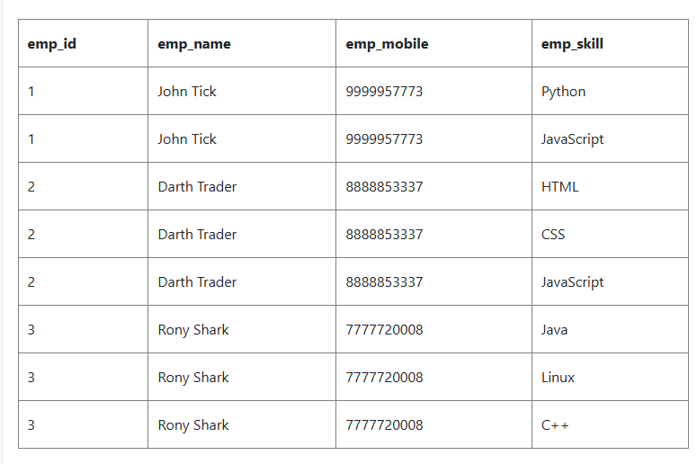
First Normal Form (1NF)

Slide 8
Second Normal Form (2NF)
For a table to be in the Second Normal Form,
It should be in the First Normal form.
And, it should not have Partial Dependency.

Slide 9
Second Normal Form (2NF)
What is Partial Dependency?
When a table has a primary key that is made up of two or more columns, then all the columns(not included in the primary key) in that table should depend on the entire primary key and not on a part of it. If any column(which is not in the primary key) depends on a part of the primary key then we say we have Partial dependency in the table.

Slide 10
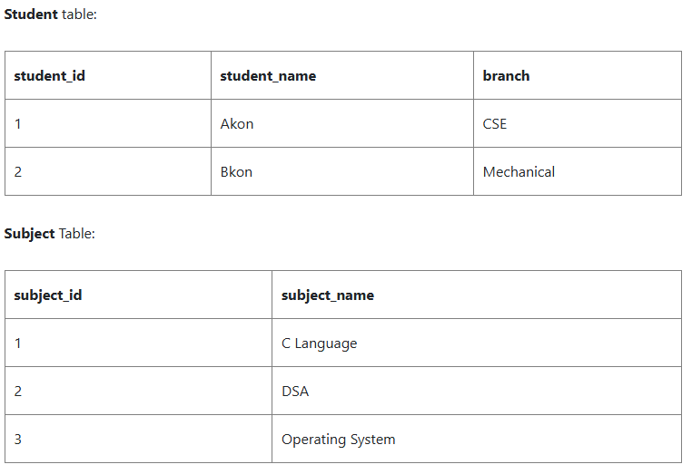
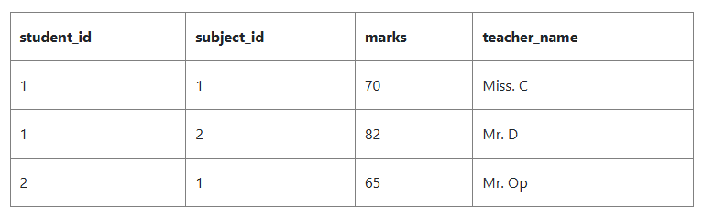
Second Normal Form (2NF)

Slide 11
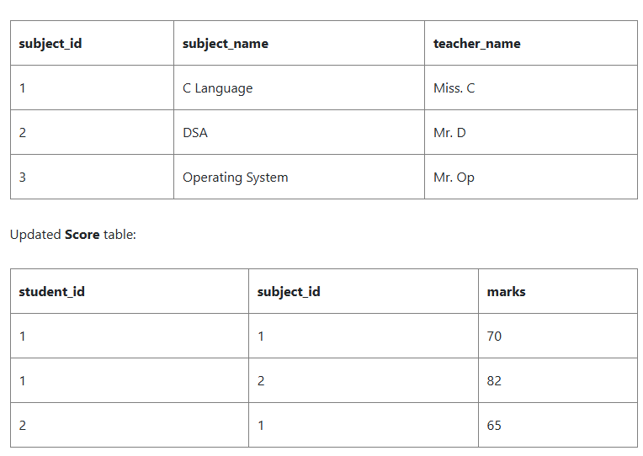
Second Normal Form (2NF)

Slide 12
3. Third Normal Form (3NF)
A table is said to be in the Third Normal Form when,
It satisfies the First Normal Form and the Second Normal form.
And, it doesn't have Transitive Dependency.

Slide 13
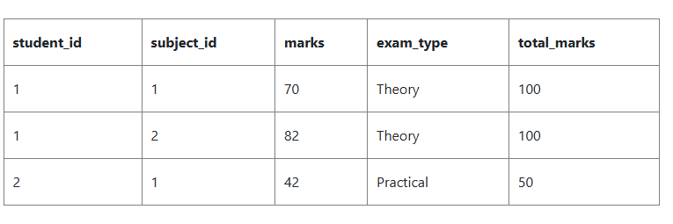
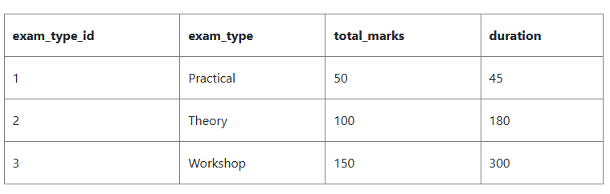
3. Third Normal Form (3NF)

Slide 14
Boyce-Codd Normal Form (BCNF)
Boyce and Codd Normal Form is a higher version of the Third Normal Form.
This form deals with a certain type of anomaly that is not handled by 3NF.
A 3NF table that does not have multiple overlapping candidate keys is said to be in BCNF.
For a table to be in BCNF, the following conditions must be satisfied:
R must be in the 3rd Normal Form
and, for each functional dependency ( X → Y ), X should be a Super Key.

Slide 15
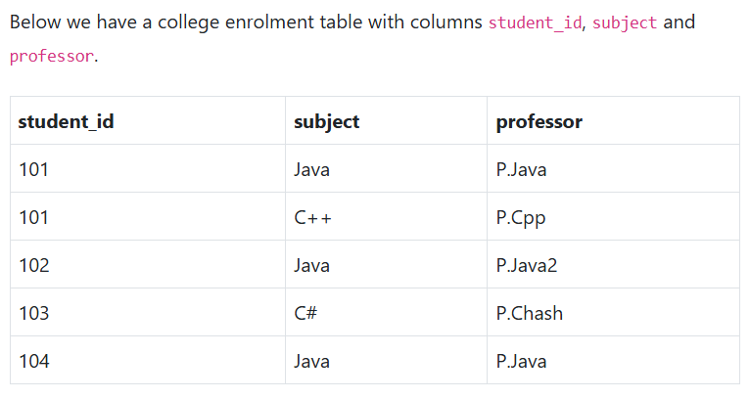
Boyce-Codd Normal Form (BCNF)
One student can enrol for multiple subjects. For example, student with student_id 101, has opted for subjects - Java & C++
For each subject, a professor is assigned to the student.
And, there can be multiple professors teaching one subject like we have for Java.

Slide 16
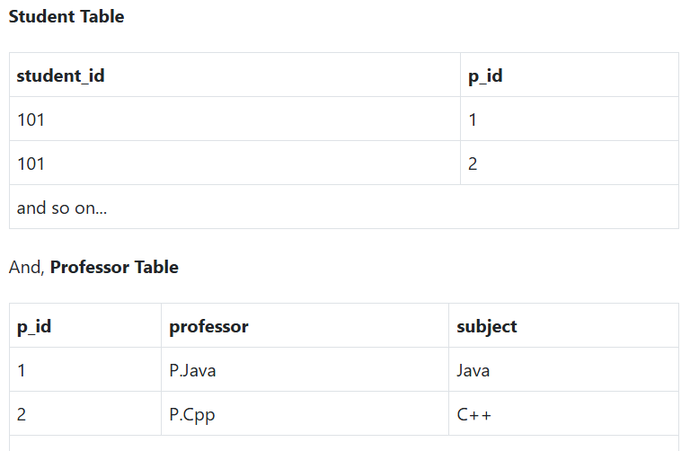
Boyce-Codd Normal Form (BCNF)
In the table above, student_id, subject form primary key, which means subject column is a prime attribute.
But, there is one more dependency, professor → subject.
And while subject is a prime attribute, professor is a non-prime attribute, which is not allowed by BCNF.

Slide 17
Fourth Normal Form (4NF)
A table is said to be in the Fourth Normal Form when,
It is in the Boyce-Codd Normal Form.
And, it doesn't have Multi-Valued Dependency.

Slide 18
Fifth Normal Form (5NF)
The fifth normal form is also called the PJNF - Project-Join Normal Form
It is the most advanced level of Database Normalization.
Using Fifth Normal Form you can fix Join dependency and reduce data redundancy.
It also helps in fixing Update anomalies in DBMS design.

